Slide 1

Road Accident Dashboard
The Main objective of this project is to analyze the Road Accident in two different years.
Finding Total Number of Casualties happened in Two years.
Which helps in getting actionable insights that will helps in reducing Road accident by taking necessary measures.

Slide 2
Key Insights :-
Primary KPI
Total Casualties
Fatal Casualties
Serious Casualties
Slight Casualties
Total Casualties by Vehicle Type
Secondary KPI
Current year Casualties vs Previous year Casualties by Monthly Trend
Casualties by Road Surface
Casualties by Road Type
Casualties by Location/Area
Casualties by Light Condition

Slide 3
Conclusion of the Analysis :-
When we see the analysis we get to know that the casualties are happened more on Car .
When you compare the casualties between two year that is 2021 and 2022, The number of casualties is Decreasing in 2022 when you compared to 2021. Which is Good and in the month of October and November The Number of Casualties are More.
Number of Casualties are more Occurred on Dry Road Surface.
Number of Casualties are more on Urban Location/Area.
Number of Casualties are more on Daylight Condition.
Number of Casualties are happened more on Single carriageway Type of Road.

Slide 4
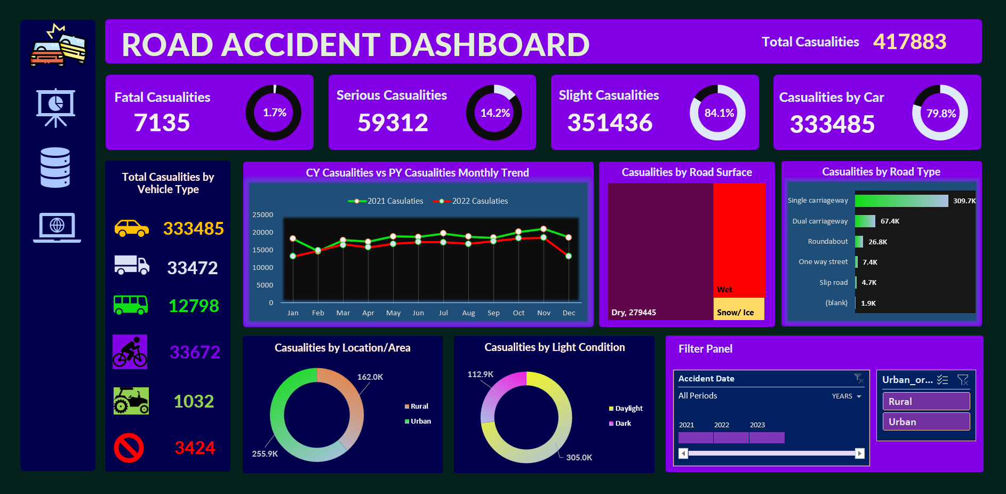
Dashboard

Slide 5
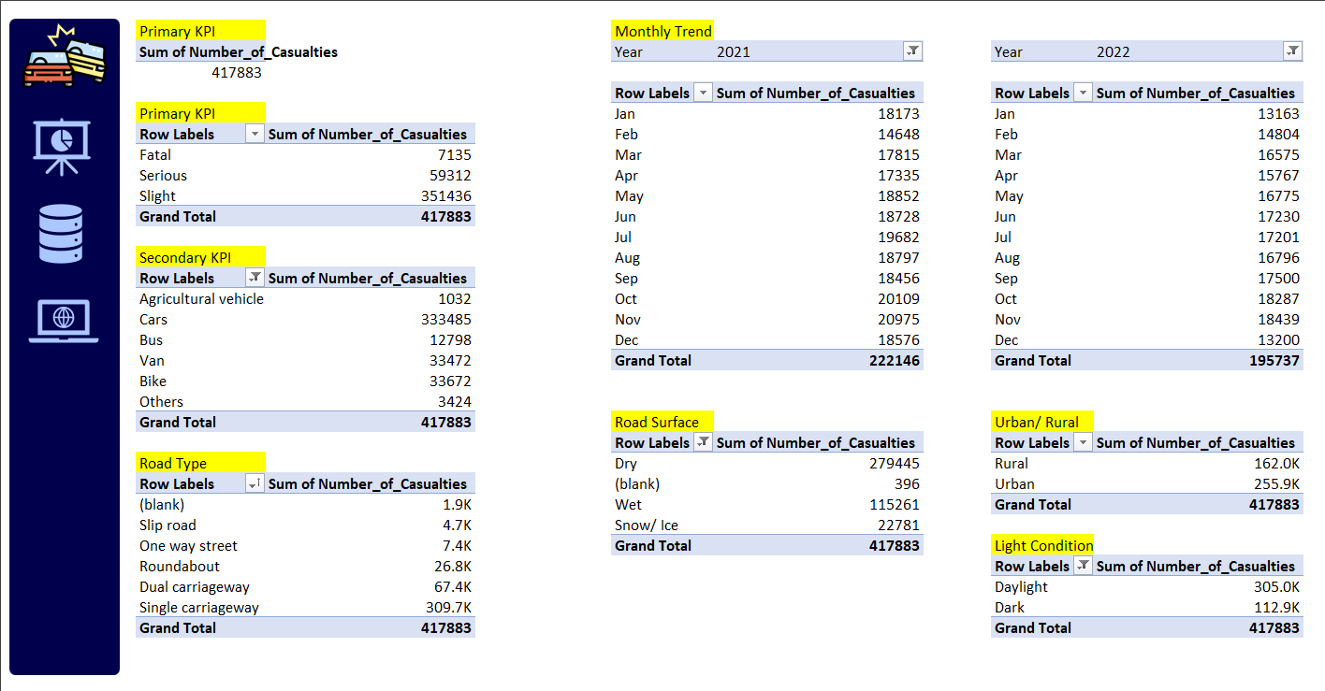
Data Analysis

Slide 6
THANK YOU

